Slide 1
Instructions for Use (this is a hidden slide – for planning only)
This presentation is designed to take about 15 minutes (if you play the whole video on slide 11)
About 1 minute per slide
Modify this deck to meet your needs and the situation
Playing the video on slide 11 (5:23 in length)…
You must be connected to the internet during the presentation
In presentation mode, take the mouse and click anywhere on the image of the video
If you don’t want to play the video, you can hide the slide (find the slide in the column on the left, right click on it and select “Hide Slide”
To change text and photos on slides…
Edit in “Normal” mode
To add your logo to the Master Slide…
Be on a slide with the “logo here” box
Select the View tab and select Slide Master – on that slide, add your logo
Close out of Master Slide view
To change or remove transitions between slides…
Select the Transitions tab and choose the transition you prefer or select “none”
To add animations to elements on slides…
Select the element you wish to animate, then select the “Animations” tab
Select the style of animation you prefer from the available menu of options

Slide 2
effective expanded learning opportunities
our vision for Anytown, Nebraska
presented to Community Organization
*expanded learning opportunities (ELOs) are school-based and community-powered afterschool school and summer programs that meet a variety of important educational and community needs
Notes:
Notes:
Add your logo and date if you desire
Change “Anytown” to the name of your community
Talking Points:
Introduce yourself, explain the purpose of this presentation – to introduce the vision for an effective afterschool program in your community, and thank the audience for the opportunity to share.
Point out the definition of expanded learning opportunities on the bottom of the slide and be purposeful about using that term rather than “afterschool”

Slide 3
end in mind
Notes:
Notes:
none
Talking Points:
Note that it’s often best to “begin with the end in mind” as the famous author and speaker, Stephen Coven, taught.
Make the point that ultimately the reason for all of this effort is to help our kids be more successful.
Explain that you could go on and on with statistics and stories about how afterschool and summer school programs help kids be more successful in school, stay out of trouble, and are more likely to be healthy contributing adults. But that would take all of our time.
Bottom line: effective afterschool programs are a huge benefit to kids

Slide 4
you might assume
Notes:
Notes:
none
Talking Points:
You might assume that after school is like daycare – just for the hours after school and before parents get off work – there’s an adult to supervise, there are snacks and there might be a game or some homework, but it’s most kids just hanging out.
This could have been your experience or the experience of your kids, but it’s the not the experience we envision.
Afterschool programs can be much more than babysitting for “latchkey kids” – that why we adopt the term expanded learning opportunities…because that’s what we intend for them to be

Slide 5
let’s start here
Our needs as a community
Notes:
Notes:
none
Talking Points:
Explain that we could spend the whole time talking about research on expanded learning programs, but what’s more important to the success of expanded learning programs is aligning them to the needs of our community.
So, let’s start there in our discussion today.

Slide 6
Effective ELOs: benefits to our community
01
Attract and retain families
Demonstrate how we value families with kids
Ease logistical concerns for parents
Be more than “daycare after school”
Notes:
Notes:
Edit as needed for your local needs
Talking Points:
Use notes on screen

Slide 7
effective ELOs: benefits to our community
02
Integrate local cultural and career priorities.
Highlight local history, events, and resources in programming
Highlight local careers and opportunities
Have kids visit local institutions & employeers
Notes:
Notes:
Edit as needed for your local needs
Talking Points:
Use notes on screen

Slide 8
effective ELOs: benefits to our community
03
Build community
Provide meaningful volunteer opportunities
Connect kids to adults in safe space
Source of community pride
Notes:
Notes:
Edit as needed for your local needs
Talking Points:
Use notes on screen

Slide 9
effective ELOs: benefits to our community
04
Improve our school(s)
Support academics beyond school day
Improve AQuESTT evidence-based analysis
Support the value of learning in school
Hands-on, engaging activities that inspire
Notes:
Notes:
Edit as needed for your local needs
Talking Points:
Use notes on screen and make the point that ELOs support “excited, engaged, inspired” learner that helps make for better students

Slide 10
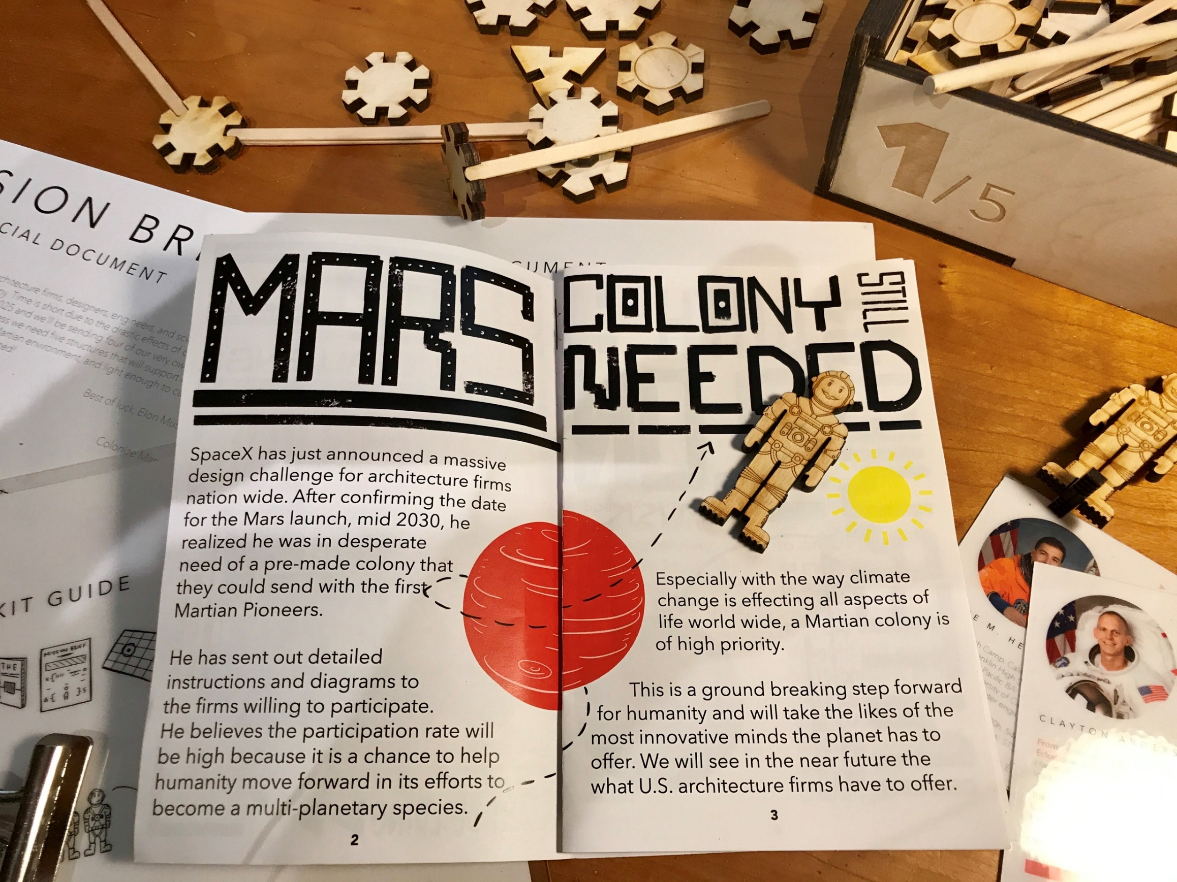
what’s required
“conventional” afterschool program
afterschool as an expanded learning opportunity (ELO)
supervision
nutrition
activity
academic development
integration with school learning
community engagement
Notes:
Notes:
Edit as needed for your local needs
Talking Points:
Use notes on screen
Make the point that effective afterschool requires more commitment and planning, but the rewards to your community are well worth it

Slide 11
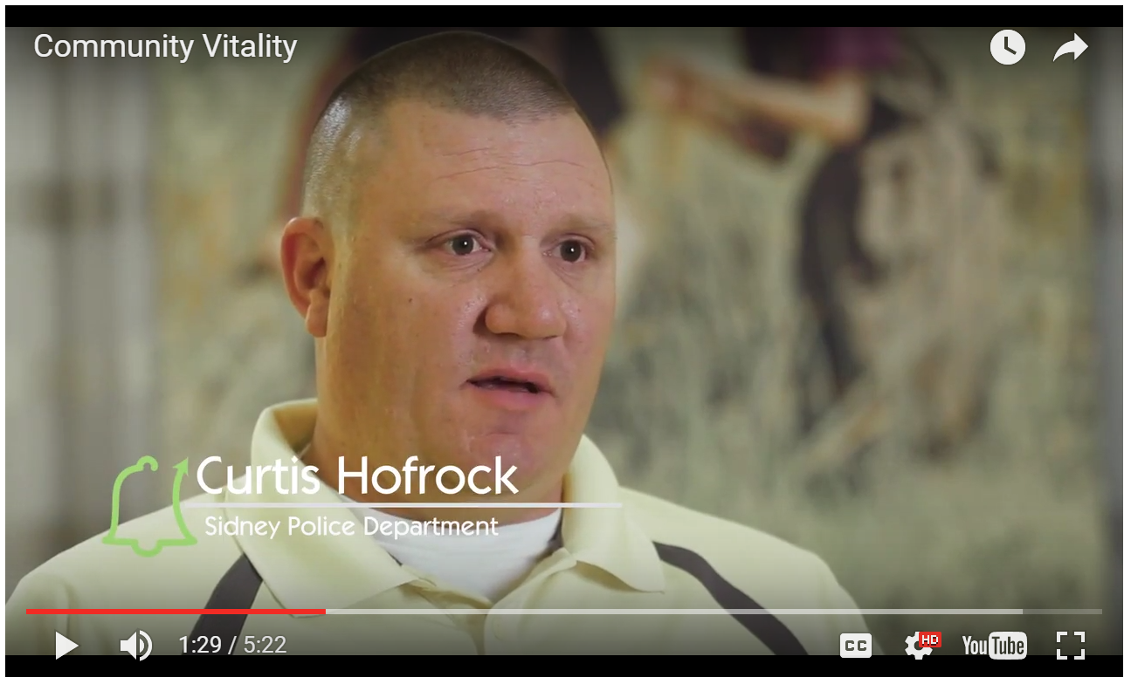
effective ELOs and community vitality
Notes:
Notes:
Use your mouse to click on the image or the video to play it
You must be connected to the Internet for the video to launch.
Talking Points:
Explain that this brief 5 minute video captures thoughts from community leaders across the state regarding how expanded learning opportunitieshelp their communities.

Slide 12
how to engage
share your ideas
Volunteer to participate in the planning efforts for the new program.
share your time
We need volunteers – regular volunteers to help with the program and as-needed volunteers to host field trips, to be guest speakers, to help make special events a reality.
lend your support
Promote our vision and plan to others in the community. And, if you are able and interested, consider financial support of the effort.
Notes:
Notes:
Edit as needed for your local needs
Talking Points:
Use notes on screen
Use the slide to make a request of the people in the room to engage and help your cause

Slide 13
more information and resources
Beyond School Bells
AQuESTT
Resources, research, ideas and tools to help ELOs be successful.
Nebraska’s measurement of school quality.
Nebraska Extension & 4-H
(our organization)
Programs and resources for Nebraska’s youth.
(brief description)
Notes:
Notes:
Edit as needed for your local needs
Talking Points:
Use notes on screen
Explain where they can find more information if they would like
Thank them for their time.

