Slide 1

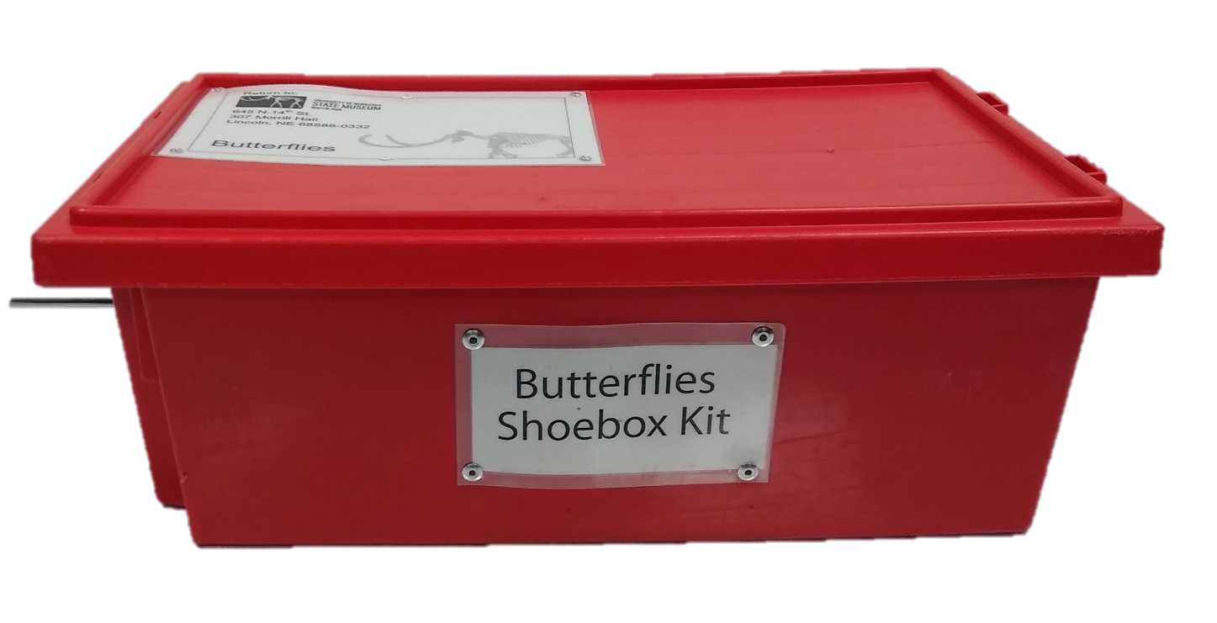
Shoebox Science Kits
Notes:
Hi, I ‘m Jennifer ruyle coming to you from morrill hall to talk to you about our shoebox science kits.

Slide 2
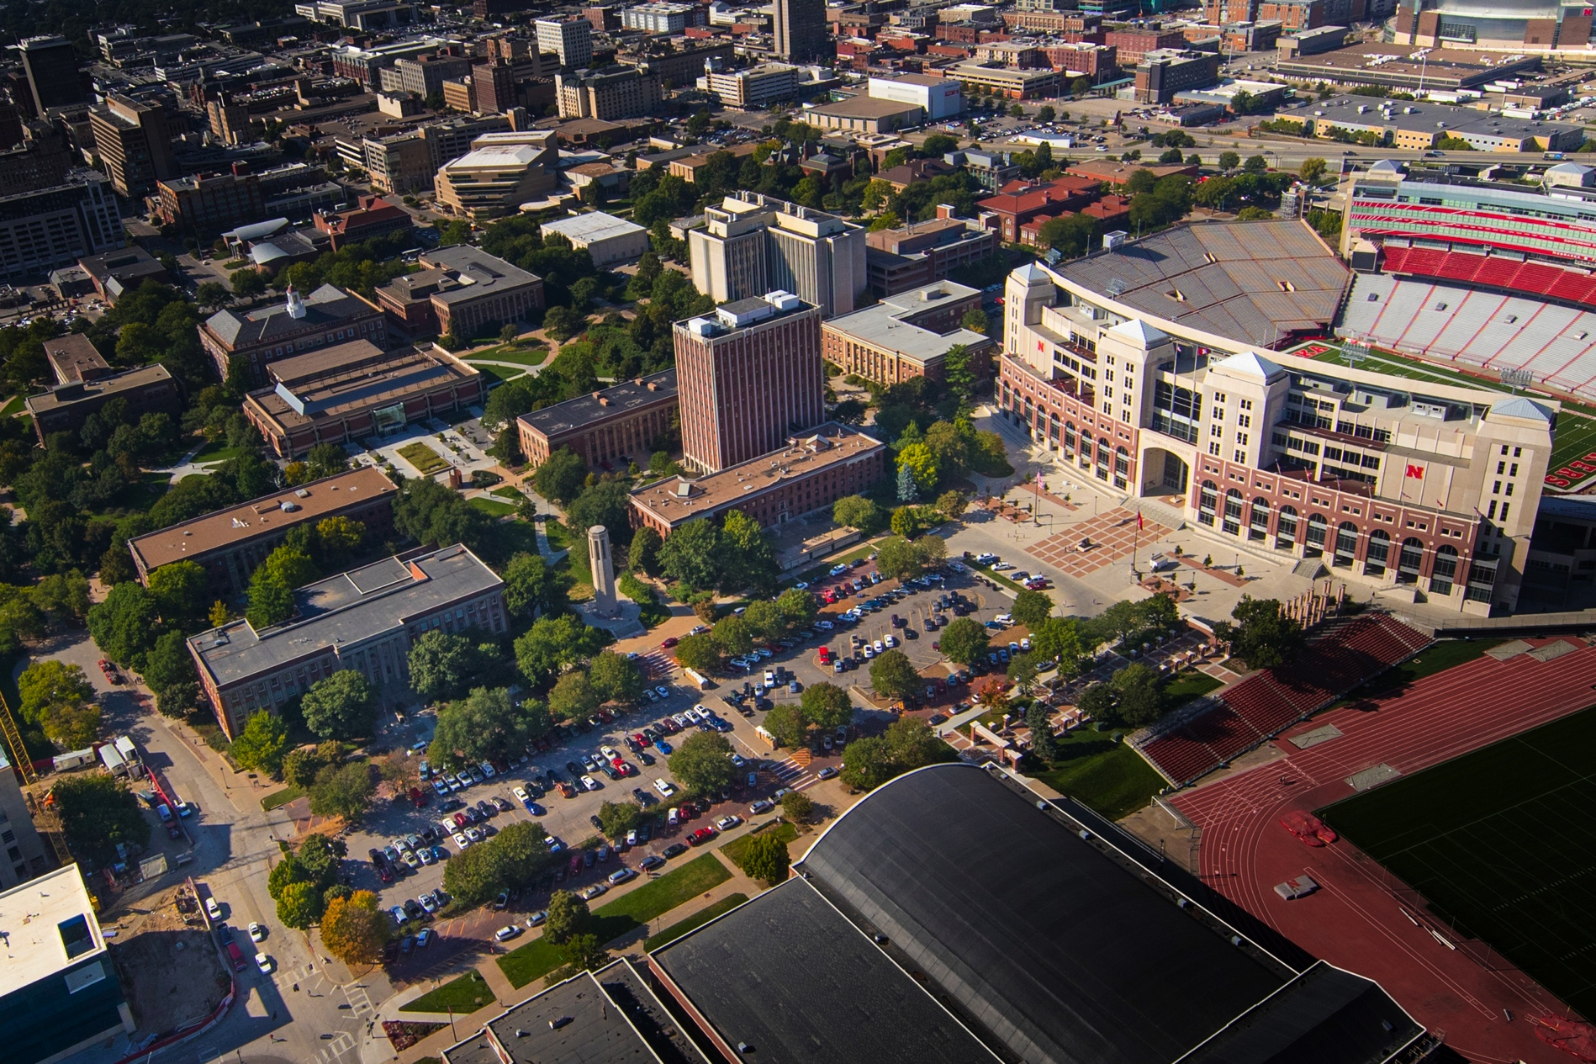

Notes:
Morrill hall is the state’s natural history museum. Our physical location is on the UNL campus in downtown Lincoln, right down the street from memorial stadium. Our museum features four floors of awesome natural history exhibits.

Slide 3
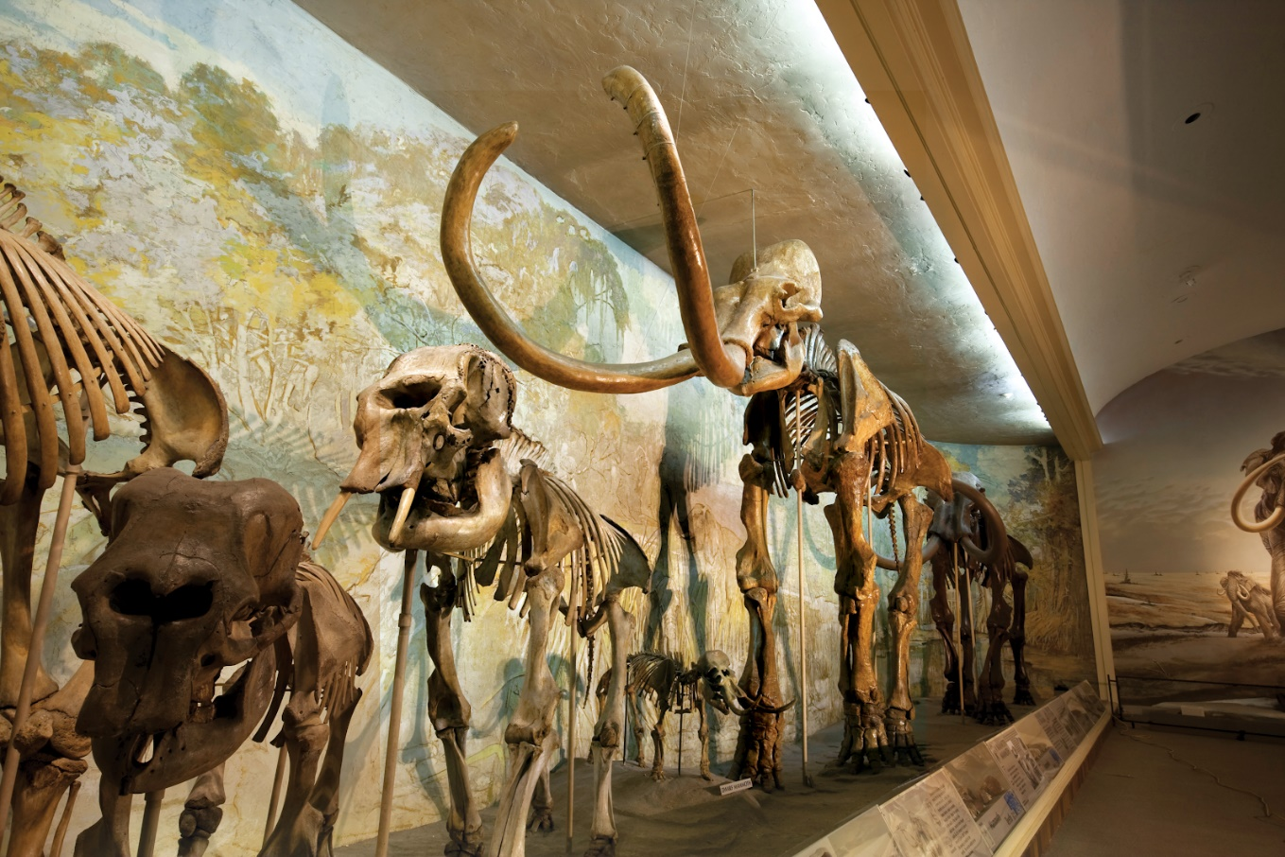
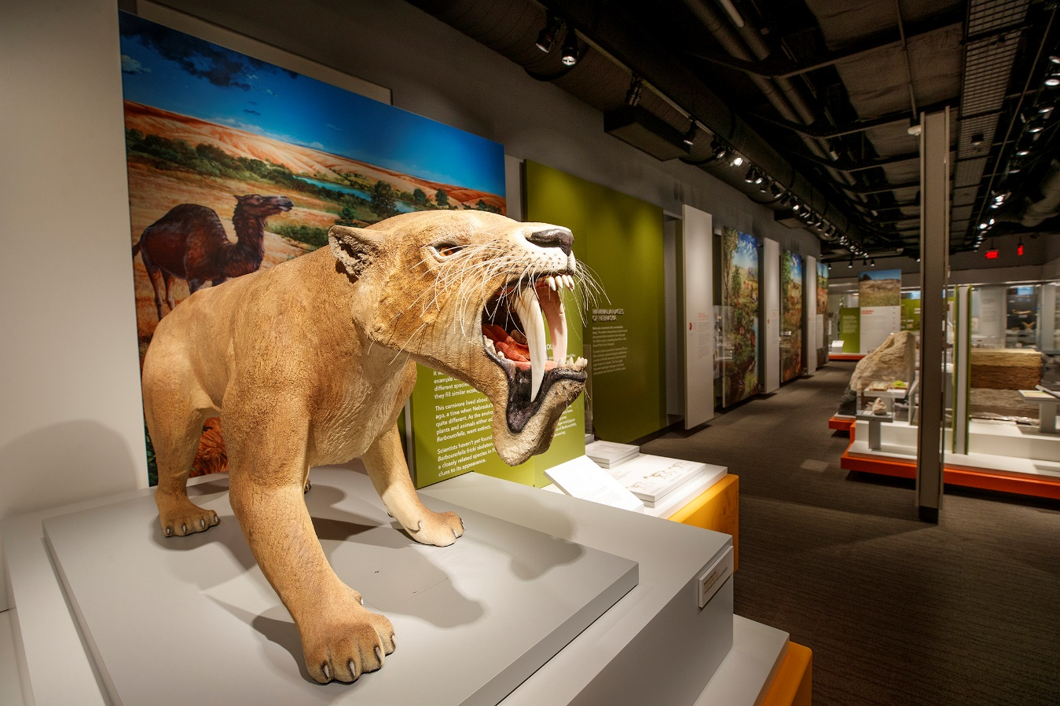
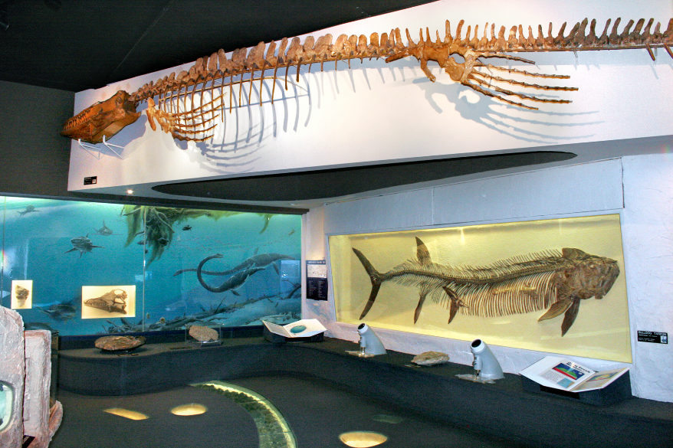
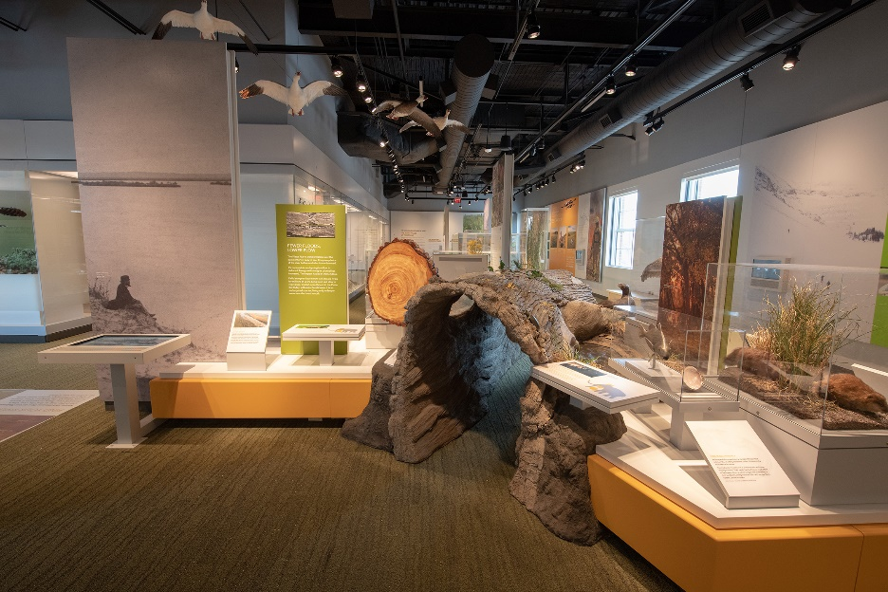
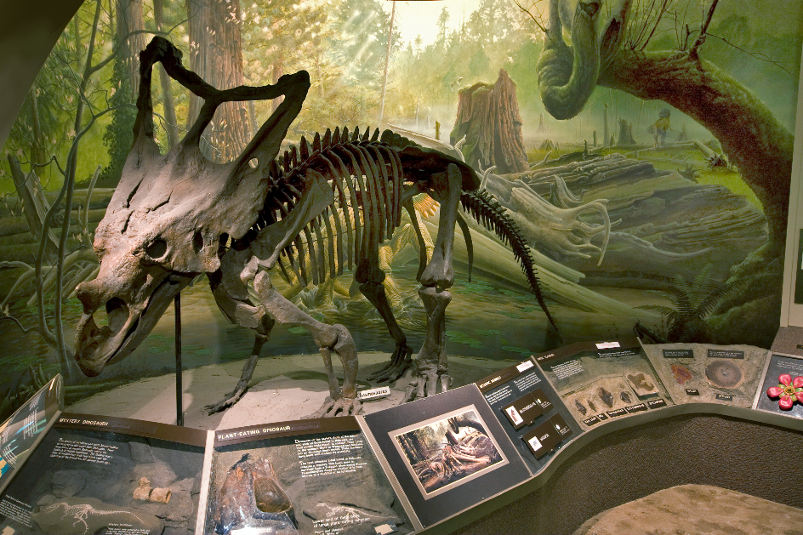
Notes:
Our museum features four floors of awesome natural history exhibits. Behind the scenes, we have teams of researchers working in our collections that study the natural world, including the plants, animals, rocks and fossils that can be found in our state. Our shoebox science kits are designed to bring the Museum to your students, wherever you are, through a small collection of specimens and objects

Slide 4
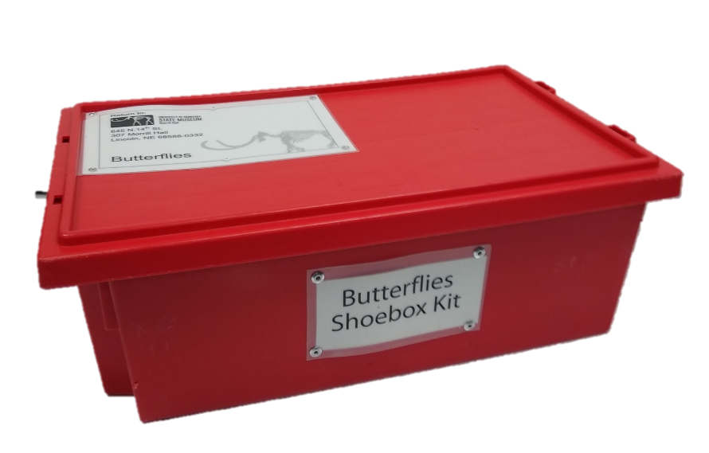
WHAT’S INSIDE?
Each shoebox kit includes a collection of specimens and a one-page user-friendly activity guide for the educator.
Kits encourage student-centered exploration in science, while providing supports for educators in how to facilitate science lessons.
Notes:
In addition to specimens, each kit includes a one-page, user friendly guide for the educator that encourages student-centered exploration in science, while providing supports for educators in how to facilitate science lessons.

Slide 5
CURRICULUM DETAILS
Grade Level
Format
Shoebox Science Kits are unique because they bring Museum specimens to students.
Curriculum in each kit encourages open exploration.
Lessons are ideal for students in grades K-5, but could also be used with 6th-8th grade.
Lessons are hands-on and ideal for an in-person program.
Notes:
Lessons are ideal for students in grades K-5, but could also be used with 6th-8th grade. Lessons are hands-on and ideal for an in-person program in which students can engage with the objects, be curious, ask questions, and look closely.

Slide 6
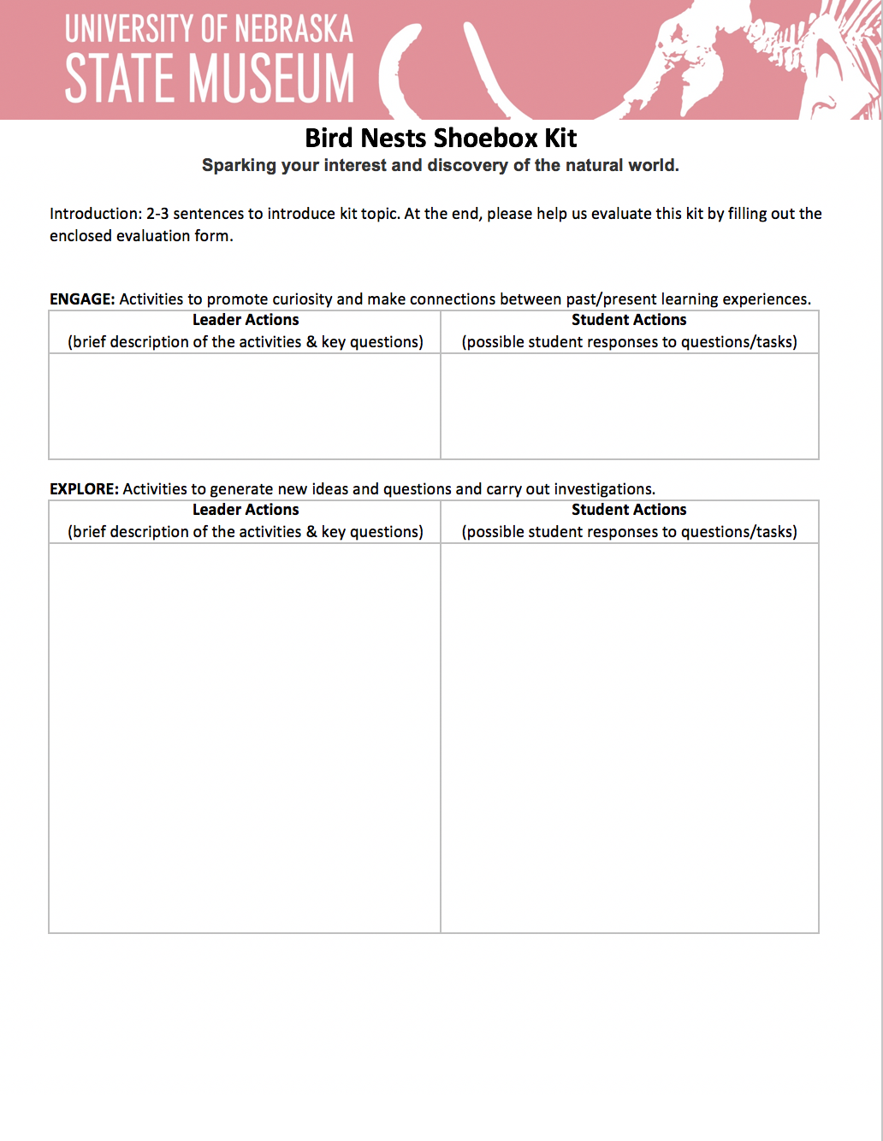
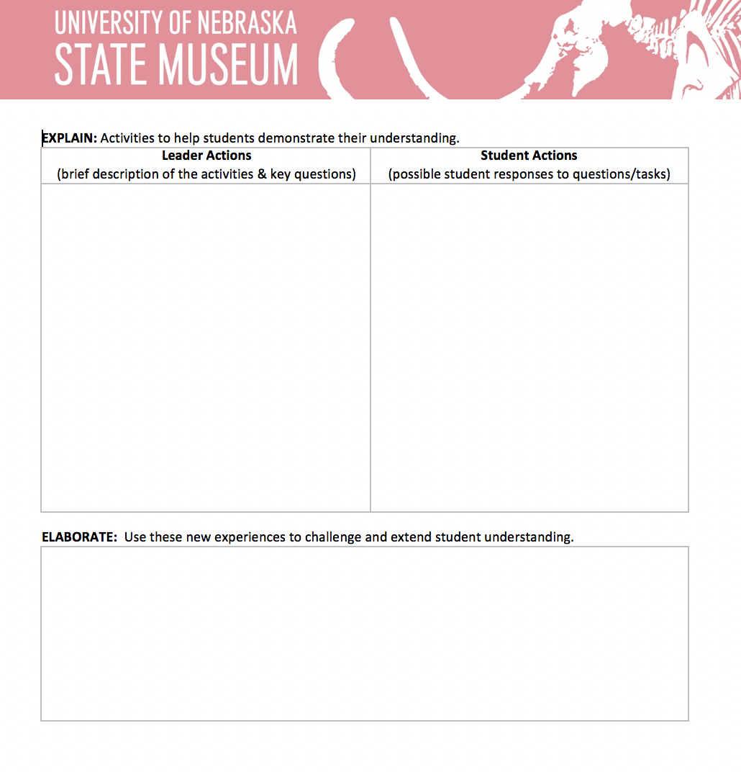
CURRICULUM DOCUMENT
The lesson for each kit follows a modified the 5E instructional model.
A brief kit introduction is given, followed by step-by-step directions.
Each step gives leader actions and student actions for additional support.
Lessons are user-friendly for leaders with a variety of experience in teaching.
Notes:
The lesson for each kit follows a modified the 5E instructional model. A brief introduction to the kit is given, followed by step-by-step directions in how to facilitate the activity. Each step provides suggested leader actions and student actions for additional support. In this way, the lessons are user-friendly for leaders with a variety of experience in teaching.

Slide 7
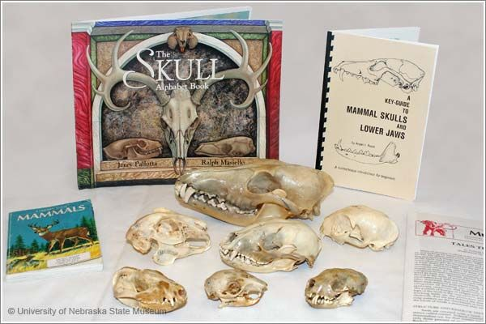
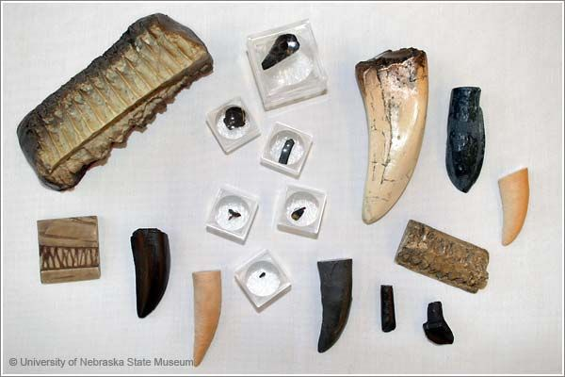
KIT TOPICS
Animal Coverings
Bird Nests*
Owls*
Butterflies
Snakes
Rocks and Minerals
Animal Skulls
Dinosaur Clues and Traces*
Dinosaur and Ancient Teeth
Dinosaur Diversity
Fossil Mammals
* Available to pilot in January
Notes:
There are 12 topics available ranging from animals to fossils to rocks and minerals. Stop share.
I’ve got a kit right here with me, and I want to show you what’s inside. This is our Animal Skulls kit. When you open the lid, you’ll find the teacher packet which includes the lesson document, a few supplemental materials, and instructions on how to mail the kit back.
Thanks for joining me today. We’re so excited for you to use our kits. Bye!

