Slide 1
Instructions for Use (this is a hidden slide – for planning only)
This presentation is designed to take about 15 minutes (if you play the whole video on slide 10)
About 1 minute per slide
Modify this deck to meet your needs and the situation
Playing the video on slide 10 (6:36 in length)…
You must be connected to the internet during the presentation
In presentation mode, take the mouse and click anywhere on the image of the video
If you don’t want to play the video, you can hide the slide (find the slide in the column on the left, right click on it and select “Hide Slide”
To change text and photos on slides…
Edit in “Normal” mode
To add your logo to the Master Slide…
Be on a slide with the “logo here” box
Select the View tab and select Slide Master – on that slide, add your logo
Close out of Master Slide view
To change or remove transitions between slides…
Select the Transitions tab and choose the transition you prefer or select “none”
To add animations to elements on slides…
Select the element you wish to animate, then select the “Animations” tab
Select the style of animation you prefer from the available menu of options

Slide 2
effective expanded learning opportunities
our vision for Anytown, Nebraska
presented to School
*expanded learning opportunities (ELOs) are school-based and community-powered afterschool school and summer programs that meet a variety of important educational and community needs
Notes:
Notes:
Add your logo and date if you desire
Change “School” to the name of your community
Talking Points:
Introduce yourself, explain the purpose of this presentation – to introduce the vision for an effective afterschool program in your community, and thank the audience for the opportunity to share.

Slide 3
goals for today
share a definition for effective expanded learning opportunities
discuss the benefits to the school, students, and the community
explain our vision for expanded learning opportunities in this community

Slide 4
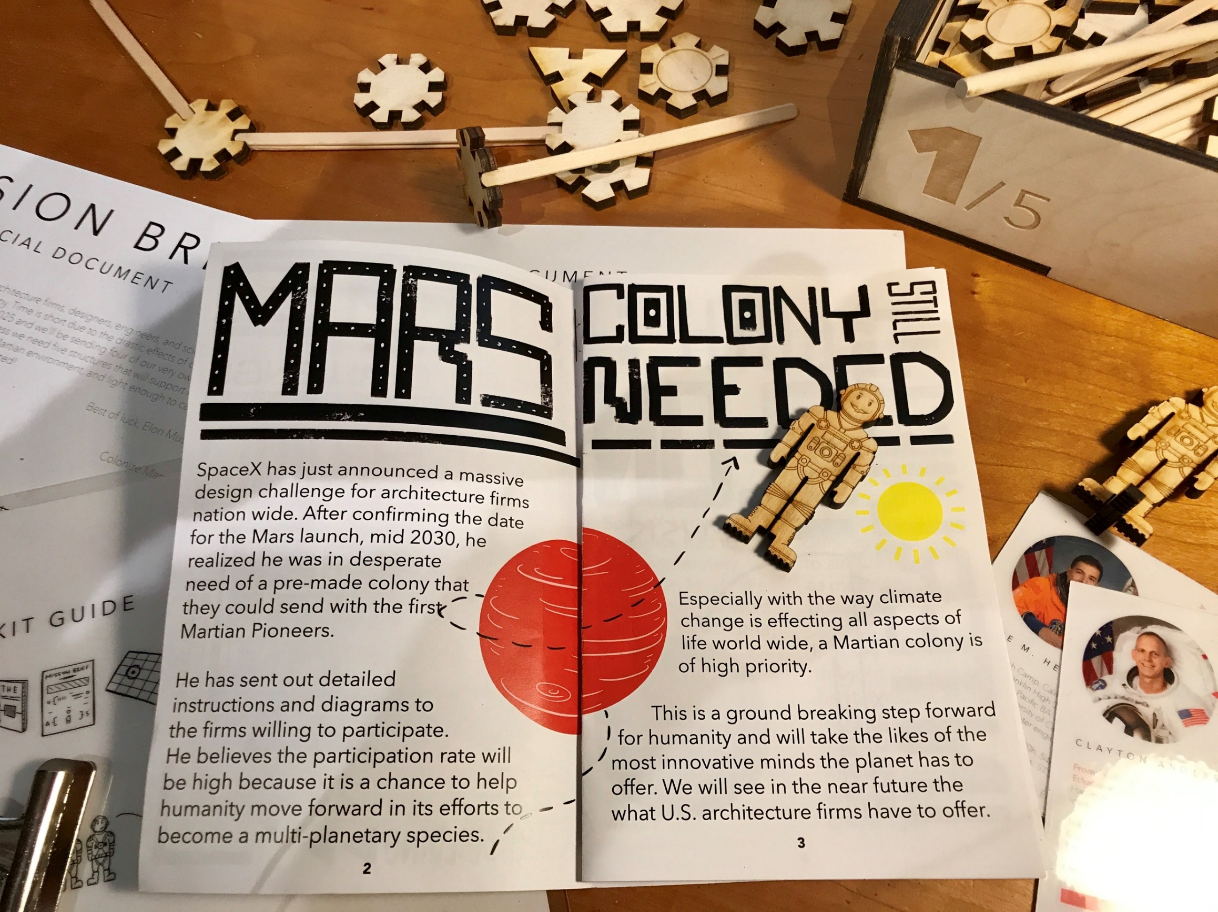
re-defining afterschool programs
“conventional” afterschool program
afterschool as an expanded learning opportunity (ELO)
supervision
nutrition
activity
academic development
integration with school learning
supports excited, engaged and inspired learners
links school-day learning to the community
Notes:
Notes:
Edit as needed for your local needs
Talking Points:
Share that they might have a pre-existing definition of afterschool programs based on their own experience, what they’ve seen in other communities, or what they read about in the media
Note that these definitions are often based on “conventional” afterschool – like a latchkey kids effort
Note that your vision for afterschool includes the components of conventional afterschool – and a whole lot more.
Contrast the convention programs with programs that are designed to be expanded learning opportunities
Use the bullets to drive home the points of differentiation
Make the point that effective expanded learning opportunities require more commitment and planning, but the rewards to your community are well worth it

Slide 5
the benefits
school, students & community
Notes:
Notes:
none
Talking Points:
Transition to discussion the benefits of an effective afterschool program that serves as an expanded learning opportunity.
Point out that most people will focus on the benefits to children – which are critically important – but benefits to the school and community are also important to note

Slide 6
effective ELOs: benefits to our students
01
engage and achieve
Increase engagement in school
Equalize skills of low-performing students
Support transitions between grades
Notes:
Notes:
Edit as needed for your local needs
Talking Points:
Use notes on screen

Slide 7
effective ELOs: benefits to our community
02
build on our success
Attract and retain families
Highlight the community through programming
Recruit businesses by demonstrating commitment to the future
Notes:
Notes:
Edit as needed for your local needs
Talking Points:
Use notes on screen

Slide 8
effective ELOs: benefits to our students & community
03
ready for college and career
Develop career readiness skills
Increase exposure to local careers and entrepreneurship opportunities
Increase STEM skills
Notes:
Notes:
Edit as needed for your local needs
Talking Points:
Use notes on screen
On the second bullet - point out ELOs can provide an “early on-ramp” to get kids thinking about a future career or enterprise in their own community
On the third bullet - emphasize that ELOs give students a place were they can try new things and not be afraid to fail

Slide 9
effective ELOs: benefits to our school
04
extend and support
Extend academics beyond school day
Improve AQuESTT evidence-based analysis
Support the value of learning in school
Leverage value of investment in the school
Notes:
Notes:
Edit as needed for your local needs
Talking Points:
Use notes on screen
On the third bullet - emphasize that ELOs support creating “excited, engaged, inspired” learners that helps make them better students during the school day

Slide 10
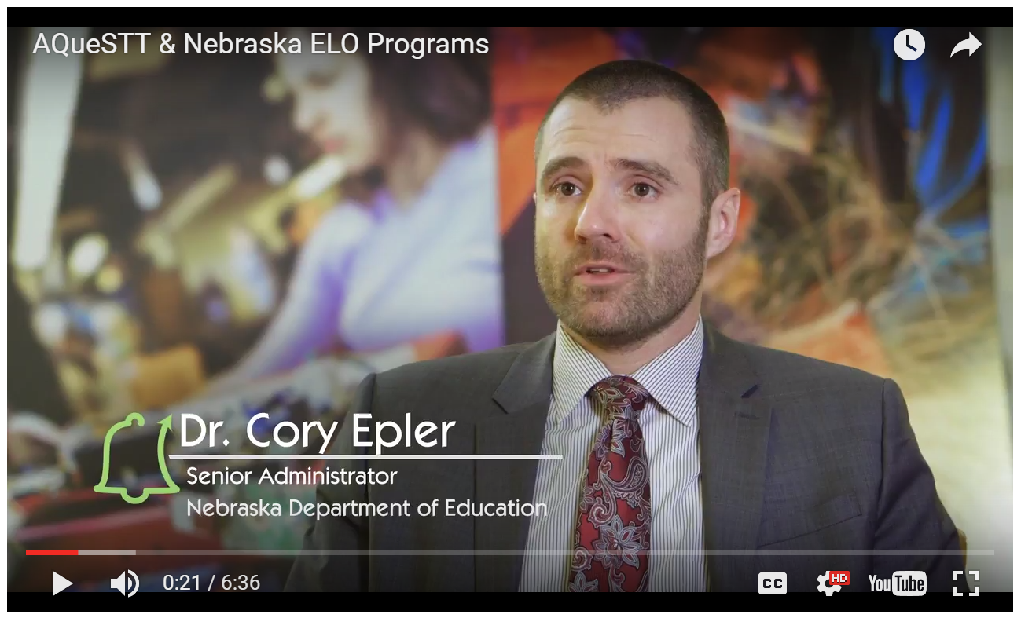
effective ELOs and AQuESTT
Notes:
Notes:
Use your mouse to click on the image or the video to play it
You must be connected to the Internet for the video to launch.
Talking Points:
Explain that this brief 5 minute video captures perspectives on how ELO programs support AQuESTT.

Slide 11
our vision for expanded learning opportunities
Point 1
Point 2
Point 3
Notes:
Notes:
Edit this slide as needed.
Talking Points:
(yours to add)

Slide 12
how to support
share your ideas
Volunteer to participate in the planning efforts for the new program.
share your time
We need volunteers – regular volunteers to help with the program and as-needed volunteers to host field trips, to be guest speakers, to help make special events a reality.
lend your support
Promote our vision and plan to others in the community.
Notes:
Notes:
Edit as needed for your local needs
Talking Points:
Use notes on screen
Use the slide to make a request of the people in the room to engage and help your cause

Slide 13
more information and resources
Beyond School Bells
AQuESTT
Resources, research, ideas and tools to help ELOs be successful.
Nebraska’s measurement of school quality.
Nebraska Extension & 4-H
(our organization)
Programs and resources for Nebraska’s youth.
(brief description)
Notes:
Notes:
Edit as needed for your local needs
Talking Points:
Use notes on screen
Explain where they can find more information if they would like
Thank them for their time.

